Slide 1



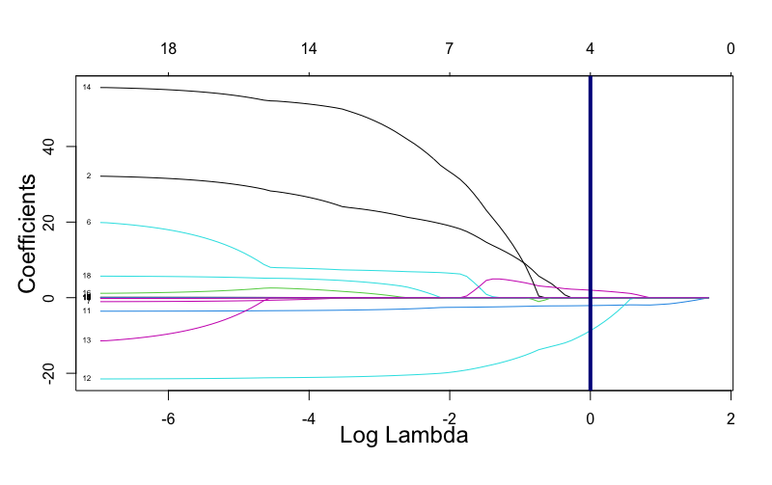
DIAMETER PREDICTION OF ASTEROIDS
JPX Tokyo Stock Exchange Prediction
Ziyun Wang (zw158), Swaminathan Venkateswaran (sv526), Juzer Poonawala (jap369), Prakhar Maheshwari (pm1178)
TEGVEER GHURA, ANTHONY MOUBARAK, RAMDAYAL REWARIA, RAGHAV SHARMA
Author One, MD, PhD; Author Two, MD; Author Three, MD
Introduction
Asteroids have always played a significant role in the history of our solar system, having existed since its formation. They have impacted Earth multiple times throughout history, causing mass extinctions and leaving a lasting impact on our planet. As a result, space organizations such as NASA continuously monitor asteroids as they pose a potential threat to Earth, and understanding their behavior and trajectory is crucial for developing effective mitigation strategies.
Knowing the diameter of an asteroid is crucial for understanding its potential impact on Earth and developing appropriate mitigation strategies. A small difference in diameter can mean the difference between a harmless atmospheric entry and a catastrophic impact.
Data Science Problems
Can Machine Learning Models help predict the diameter of an incoming asteroid based on some of its features? How do the models’ accuracy vary between them?
What are the most important asteroid features that help predict the diameter of an asteroid ?
Dataset
This project utilized data provided by NASA's Jet Propulsion Laboratory, which contains over 20 numerical variables that describe more than 130,000 asteroids. However, some features had to be dropped due to a high number of empty values and/or being populated exclusively by one or two values.
Methods
XGBoost – Uses gradient boosting and decision tree-based techniques to achieve high predictive accuracy and speed on structured datasets.
MLPRegressor – Uses multi-layer perceptron architecture for predicting continuous numeric values.
Gradient Boosting – Uses an ensemble of weak prediction models, such as decision trees, to iteratively correct the errors of previous models and achieve high accuracy on supervised learning tasks.
Random Forest Regressor – An ensemble machine learning algorithm that uses multiple decision trees and bootstrap aggregation to predict continuous numeric values.
Data Exploration
The stock types range from ETFs (similar to mutual funds) to Mothers (the section for only shares of startup companies to list and trade).
Leading industries can spearhead national productivity growth overall, therefore three pillar industries will be assessed in this project: Information & Communication, Services, and Retail trade.
The Information and Communications Technology (ICT) industry in Japan is touted to be the top industry in the country.
The Services industry accounts for approximately 70% of Japan's gross domestic product (GDP) and approximately 75% of employment, so any insights in this industry can have a large impact on Japan's economy. Retail trade industry contributes steadily for more than ten percent to Japan’s GDP. While the wholesale market has been stagnating in recent years, retail sales have been on an upward trend with the food industry representing the largest retail segment.
Results
Whole Economy
RMSE (Root Mean Squared Error) is the metric used to compare the four models, as it measures the difference between the predicted and actual values. It provides an intuitive understanding of the error magnitude, is sensitive to outliers, and can be easily interpreted in the context of the problem domain.
All four models were trained on the four selected features and compared against a baseline Linear Regression model trained on the same variables. All models achieved better RMSE scores than the baseline LR model, with Random Forest Regression having the best performance, achieving an RMSE of 0.17.
Top 3 Industries
The accuracy for predicting (binary; 1 – up, 0 – down) whether the top 3 industries within Japan will go up or down is seen below. This was calculated by selecting the 3 most represented industries and taking their respective stocks.
Conclusion
Overall, the second day's overall close prices at JPX Tokyo Stock Exchange and the three pillar industries are simply unpredictable as our accuracy rates stagnated at 50%-ish. However, we still have faith in Japan’s economy as its stock market continues to stay volatile and reacts quickly with policy change and world dynamics.
The coming decade will bring an ongoing wave of innovation in manufacturing all over the world.
The retail sector can make a quantum leap in performance by deploying new technologies, responding to changing demographics, and increasing its efficiency.
There is no doubt that Japan has an alarming aging population problem that is dragging its economy back, therefore it is critical for the Japanese government to take practical measures on how to leverage its reputable pillar industries and to keep up in the global competition.
Limitation / Future Works
The biggest limitation regarding this project is its tunneled scope to only using stocks as well as not incorporating the ”time” aspect in dealing with stocks. The ongoing Kaggle competition provided datasets to include options, securities, secondary stock prices, time of trade, etc. Incorporating these add-ons coupled with more enhanced machine learning models (ex: LightGBM, Gated Recurrent Unit, LSTM, etc.) would yield a more accurate result of predicting Japan’s economy of tomorrow.
References
https://www.kaggle.com/competitions/jpx-tokyo-stock-exchange-prediction/overview
https://xgboost.readthedocs.io/en/stable/python/python_api.html
https://scikit-learn.org/stable/modules/generated/sklearn.linear_model.LogisticRegression.html
https://scikit-learn.org/stable/modules/generated/sklearn.ensemble.RandomForestClassifier.html
https://scikit-learn.org/stable/modules/neural_networks_supervised.html
https://scikit-learn.org/stable/modules/generated/sklearn.ensemble.BaggingClassifier.html
Acknowledgement
We would like to thank Dr. Nakul, Dr. Purna, as well as Georgetown University Graduate School of Arts & Sciences. We would also like to acknowledge the Data Science & Analytics (GSAS) program at Georgetown University.
Machine Learning Model | Accuracy
XG Boost | 0.39
Gradient Boosting | 0.40
Random Forest Regressor | 0.17
MLP Regressor | 0.41
Baseline Linear Regression | 0.75
Table 1 – Machine Learning model vs. RMSE
Figure 3 – ROC curve for predicting the Japanese Economy via all stocks.
Figure 1 – Tree Map depicting the most represented industries within the Japanese stock exchange.
Machine Learning Model | Information & Communication Accuracy | Retail Trade Accuracy | Services Accuracy
XG Boost | 0.4125 | 0.5125 | 0.54167
Logistical Regression | 0.5083 | 0.475 | 0.55
Random Forest | 0.4375 | 0.4708 | 0.5417
1 Layer Neural Network | 0.5083 | 0.475 | 0.55
Bagging | 0.4708 | 0.45 | 0.5292
Figure 2 – Bar Graph depicting the most represented sectors within the Japanese stock exchange.
Table 2 – Machine Learning model vs. Accuracy (industry specific stocks)

